Slide 1

TRAFFIC FORECASTING – TIME SERIES USING RNN
Reshma Jayaprakash
Scifor Technologies Trainee
ID: STB03011

Slide 2
INTRODUCTION
Traffic congestion has always been a crucial aspect of urban planning but has become a serious issue that must be addressed due to the rapid increase in the number of vehicles and transportation demand
Traffic signal control is an important tool in traffic flow management as it is considered as one of the most effective ways to reduce traffic congestion at intersections
Because of vehicle flow interactions within the network, human behavioral considerations, stochastic traffic demand, and traffic accidents, the Intersection Traffic Signal Control Problem (ITSCP) is a complex problem
Traditional time series forecasting methods are often inadequate for capturing the complexities of traffic patterns. Hence, this project employs GRU, a type of recurrent neural network (RNN), renowned for its effectiveness in modeling sequential data

Slide 3
OBJECTIVE
To Build a Gated Recurrent Unit (GRU) model tailored for time series analysis of traffic data
Develop an interactive and user-friendly application using Streamlit for visualizing and understanding traffic forecasts
Provide users with actionable insights into future traffic conditions, fostering informed decision-making
Enhance traffic management strategies by enabling a proactive approach to address potential congestion issues
By achieving these objectives, the project contributes to the development of efficient and accessible tools for urban traffic forecasting, ultimately leading to improved traffic management and enhanced urban mobility

Slide 4
PROJECT WORKFLOW
1. Data Collection
6. Model Deployment
2. Data Exploration
5. Inversing Transformation of Data
3. Data Transformation & Preprocessing
4. Model Building & Fitting the Model

Slide 5
DATA COLLECTION
This dataset is a collection of numbers of vehicles at four junctions at an hourly frequency.
The CSV file provides four features:
DateTime
Junctions
Vehicles
ID
The sensors on each of these junctions were collecting data at different times, hence the traffic data from different time periods
Some of the junctions have provided limited or sparse data
This data consist of 48120 instances

Slide 6
DATA EXPLORATION
This collection of data starts from 11/01/2015, 00:00 and ends at 06/30/2017, 23:00
Junction 1, Junction 2 and Junction 3 has total of 14592 entries out of 48120
In Junction 4 there is only limited data, that is of 4344 entries
Initial Process,
Parsing Dates
Plotting Time Series
Feature Engineering for EDA
Parsing Dates – It is a process of converting date and time information in a dataset from a string format to a datetime format.
In Python, the pandas library provides a convenient method to parse dates using the pd.to_datetime() function. This conversion allows for easier handling and analysis of time-related data.

Slide 7
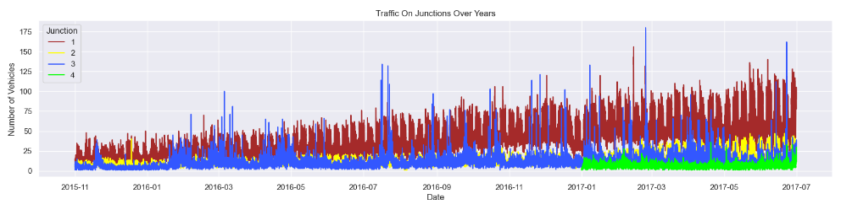
Plotting Time Series - Traffic on Junctions over Years has been plotted using Seaborn library.
Here, It can be seen that the Junction 1 is visibly having an upward trend
The data for the Junction 4 is sparse starting only after 2017
Seasonality is not evident from the above plot. So datetime composition has been explored to figure out more about it
Trend and Seasonality are the components of Time Series
Trend – is a long term movement observed in time series that changes over time which can be either positive (increasing) or negative (decreasing)

Slide 8
Seasonality – is a periodic fluctuation that occurs in time series where predictable and regular patterns are exhibited at intervals
Here, we have plotted seasonality graphs by doing Feature Engineering
Feature Engineering for EDA – Created new features out of DateTime and plotted using seaborn library
New Features:
Year
Month
Date in the given month
Days of week
Hour

Slide 9
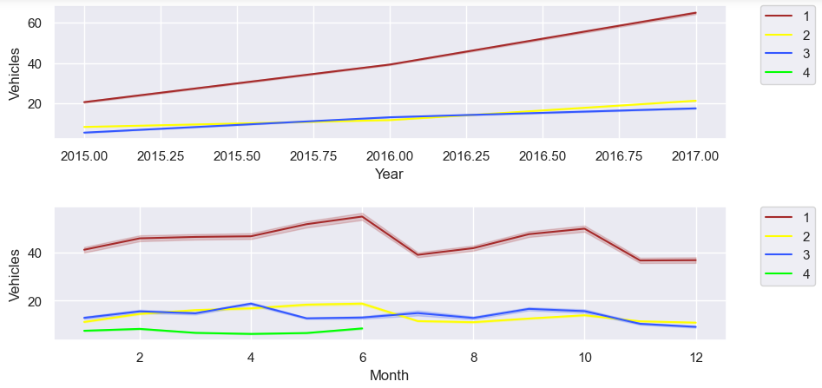
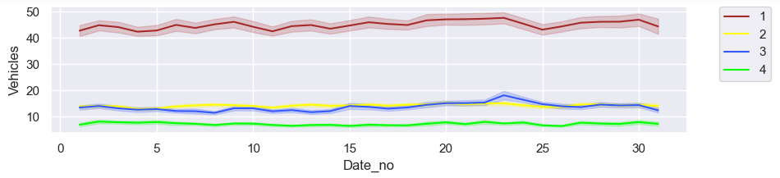

Slide 10
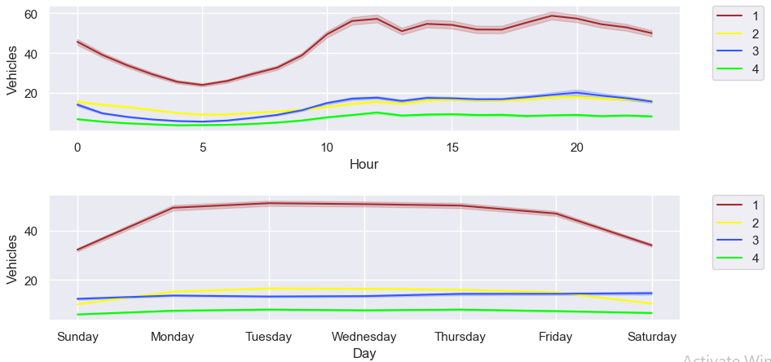
Yearly, there has been an upward trend for all junctions except for the fourth junction due to the sparse data in Junction 4
We can see that there is an influx in the first and second junctions around June, this may be due to summer break and activities around the same

Slide 11
Monthly, throughout all the dates there is a good consistency in data
For a day, we can see that there are peaks during morning and evening times and a decline during night hours
For weekly patterns, Sundays enjoy smoother traffic as there are lesser vehicles on roads. Whereas Monday to Friday the traffic is steady

Slide 12
DATA TRANSFORMING & PREPROCESSING
The span of data from all four junctions is not the same. Data provided for the fourth junction is limited to only 2017
The yearly trend for Junctions one, two and three have different slopes
Junction 1 has a more strong weekly seasonality in comparison to the other junctions
So here, transforming is applied to transform non-stationary time series to stationary by using the method differencing
Preprocessing Steps,
Created different frames for each Junction
Transforming the series
Performed the Augmented Dickey-Fuller test to check the seasonality of transformed series
Creating test and train sets

Slide 13
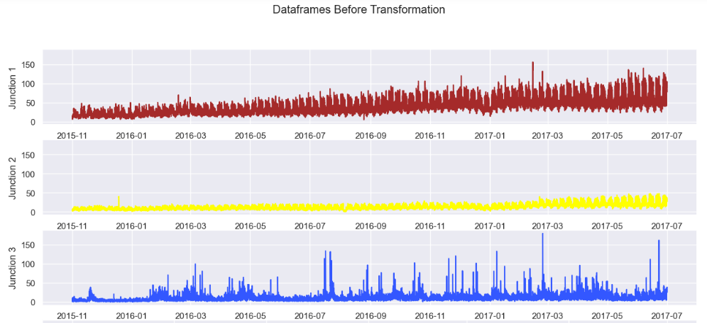
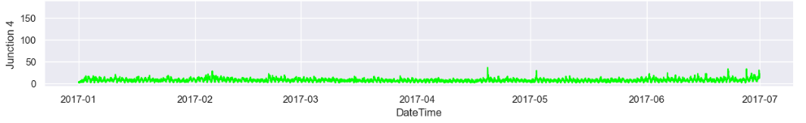
Different frames for each Junction

Slide 14
A time series is stationary if it does not have a trend or seasonality
From the analysis made, we have seen a weekly seasonality and an upwards trend over the years
In the above plot, it is again seen that the Junctions one and two have an upward trend. If we limit the span we will be able to further see the weekly seasonality
Hence Transforming – Normalizing and Differencing has applied
Transforming the series
In accordance with the above observations, Differencing to eliminate the seasonality should be performed as follows:
For Junction 1, I will be taking a difference of weekly values.
For Junction 2, the difference of consecutive days is a better choice
For Junctions 3 and 4, the difference of the hourly values will serve the purpose

Slide 15
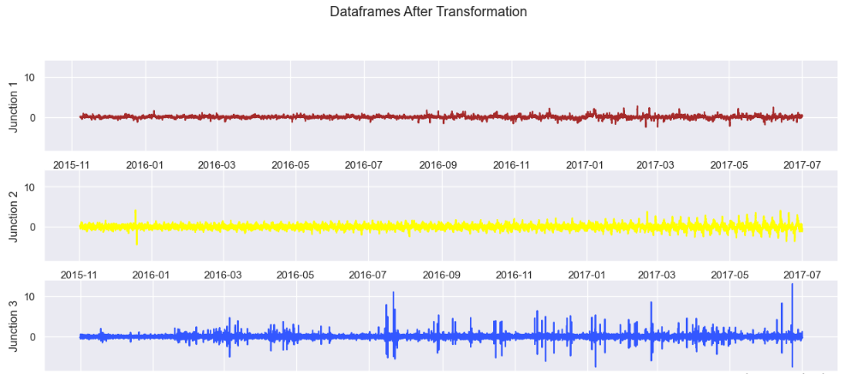
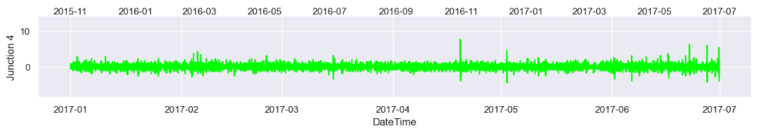

Slide 16
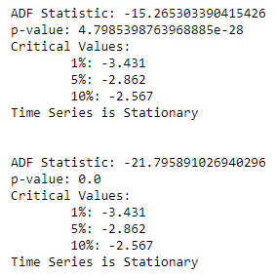
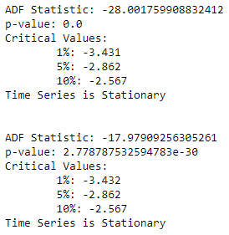
Augmented Dickey-Fuller test
This test is a statistical hypothesis test used to determine the presence of a unit root in a time series dataset. A unit root suggests that a time series has a stochastic trend and is non-stationary. The ADF test assesses whether differencing the series can make it stationary.

Slide 17
Creating Test and Train Data
Preprocessing the data for Neural Network
Splitting the Test and Train sets
Assigning X as Features and y as Target
Reshaping data for Neural Network
90% of the data is used for training (train), and the remaining 10% is used for testing (test)
The TnF function is defined to create features (X) and targets (y) from the differenced time series data
The steps parameter is used to determine the size of the sliding window to create features. It has been set to 32
The shapes of X_train and X_test are adjusted to be compatible with the expected input shape for a neural network model
Features (X_train, X_test) and targets (y_train, y_test) are assigned for each junction (J1, J2, J3, J4)

Slide 18
MODEL BUILDING & FITTING THE MODEL
For model building, I have used Gated Recurrent Unit (GRU). Created a function for the neural network to call on and fit the data frames for all four junctions
It uses the Sequential model from Keras to stack layers
The model architecture consists of multiple GRU layers with dropout to prevent overfitting
The last layer is a Dense layer with one unit, as it's a regression problem predicting a single value
The model is compiled using Stochastic Gradient Descent (SGD) as the optimizer and Mean Squared Error (mean_squared_error) as the loss function
Training is done with the specified number of epochs, batch size, and learning rate schedule

Slide 19
Neural Network Structure
Input Layer:
Type: GRU layer
Number of Units: 150
Activation Function: Hyperbolic Tangent (tanh)
Dropout Layer:
Rate: 0.2 (to prevent overfitting)
GRU Layer:
Number of Units: 150
Activation Function: Hyperbolic Tangent (tanh)
Dropout Layer:
Rate: 0.2
GRU Layer:
Number of Units: 50
Activation Function: Hyperbolic Tangent (tanh)
Dropout Layer:
Rate: 0.2

Slide 20
GRU Layer:
Number of Units: 50
Activation Function: Hyperbolic Tangent (tanh)
Dropout Layer:
Rate: 0.2
GRU Layer (Final):
Number of Units: 50
Activation Function: Hyperbolic Tangent (tanh)
Dropout Layer:
Rate: 0.2
Dense (Output) Layer:
Number of Units: 1 (as it's a regression problem predicting a single value)
The model is compiled using Stochastic Gradient Descent (SGD) as the optimizer with a learning rate of 0.01. The training is done for 50 epochs with a batch size of 150. Additionally, early stopping with a patience of 10 is used to prevent overfitting, and a learning rate scheduler is applied to adjust the learning rate during training.

Slide 21

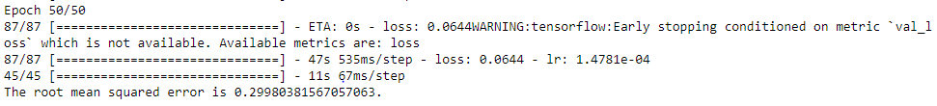
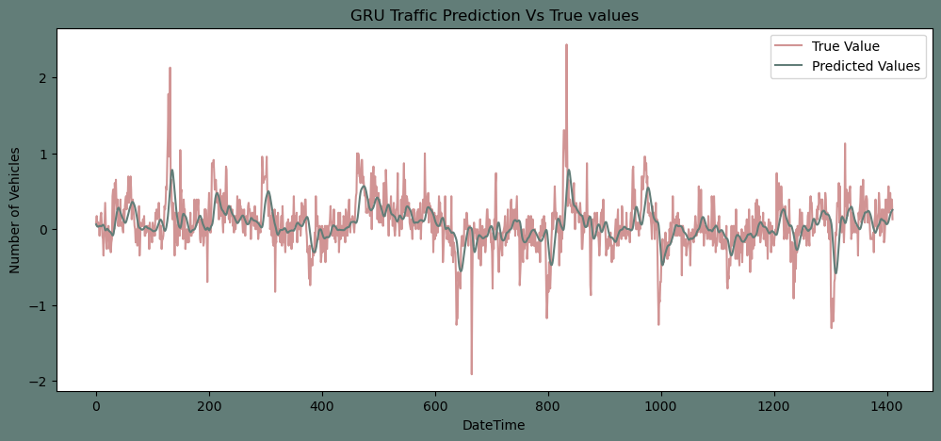
Model Fitting – Junction 1

Slide 22

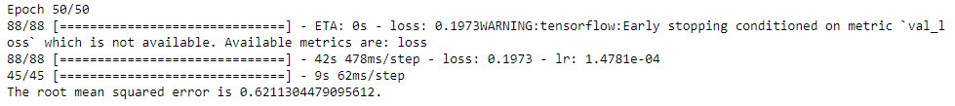
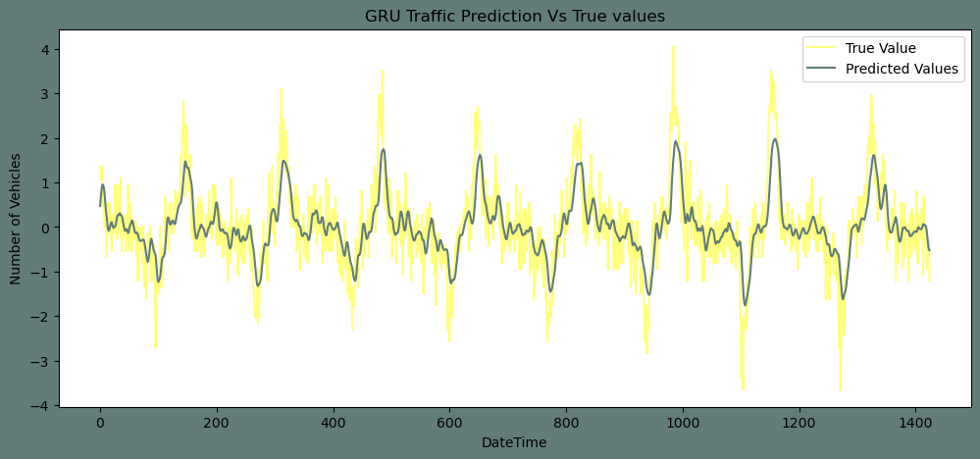
Model Fitting – Junction 2

Slide 23

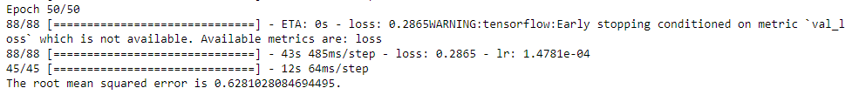
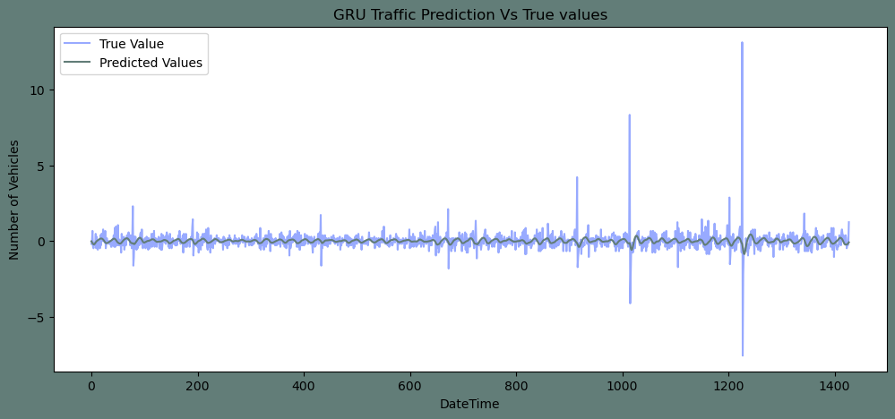
Model Fitting – Junction 3

Slide 24

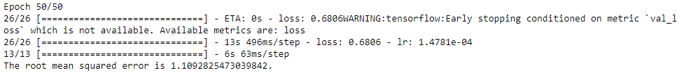
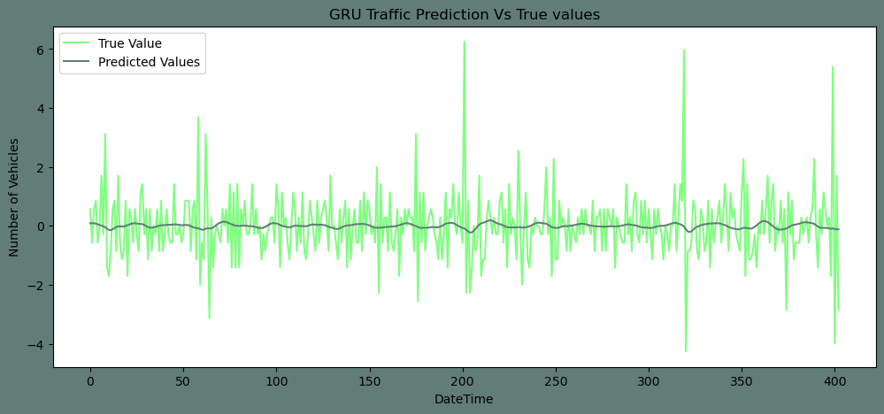
Model Fitting – Junction 4

Slide 25
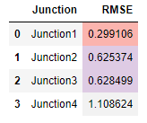

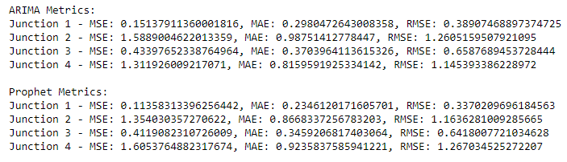
Model Evaluation - GRU
Model Evaluation – Comparing with ARIMA and Prophet

Slide 26
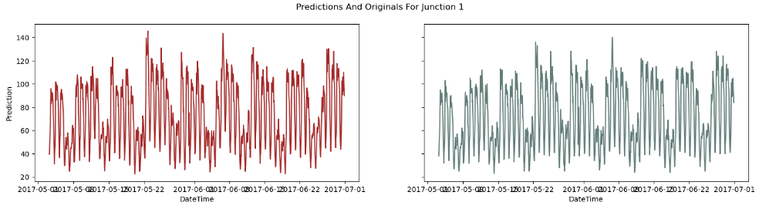
INVERSE TRANSFORMATION OF DATA
Inversed transforms that I applied to the datasets to remove the seasonality and trends. This step is performed to make the predictions get back on the accurate scale.
The model takes sequences of length 32 and predicts the next time step.

Slide 27
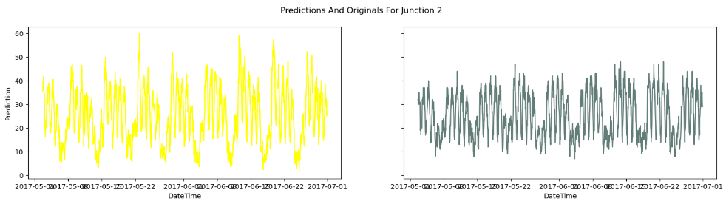
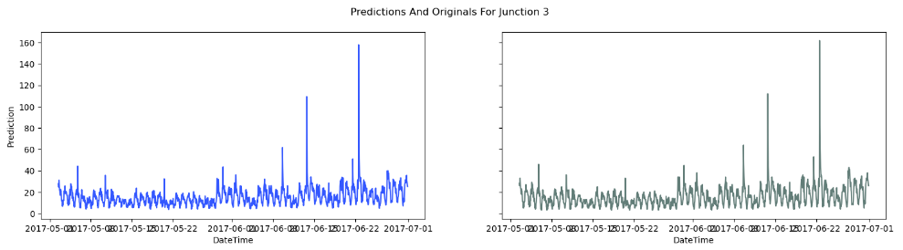

Slide 28
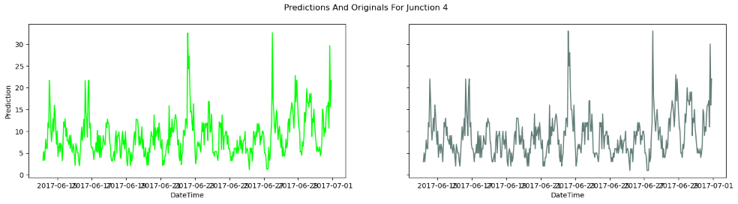

Slide 29
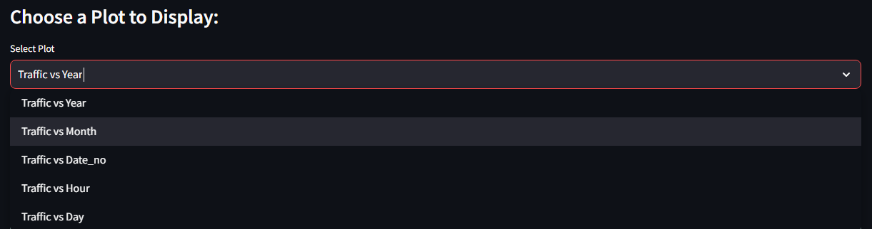
MODEL DEPLOYMENT
A Streamlit application has been built to understand and analyze Traffic Predictions and Forecasting.
Dashboard URL: https://traffic-forecasting-jpreshma.streamlit.app/
Features:
Data Visualization of Traffic on Junctions over Years
Time Series Analysis to understand Trend and Seasonality

Slide 30
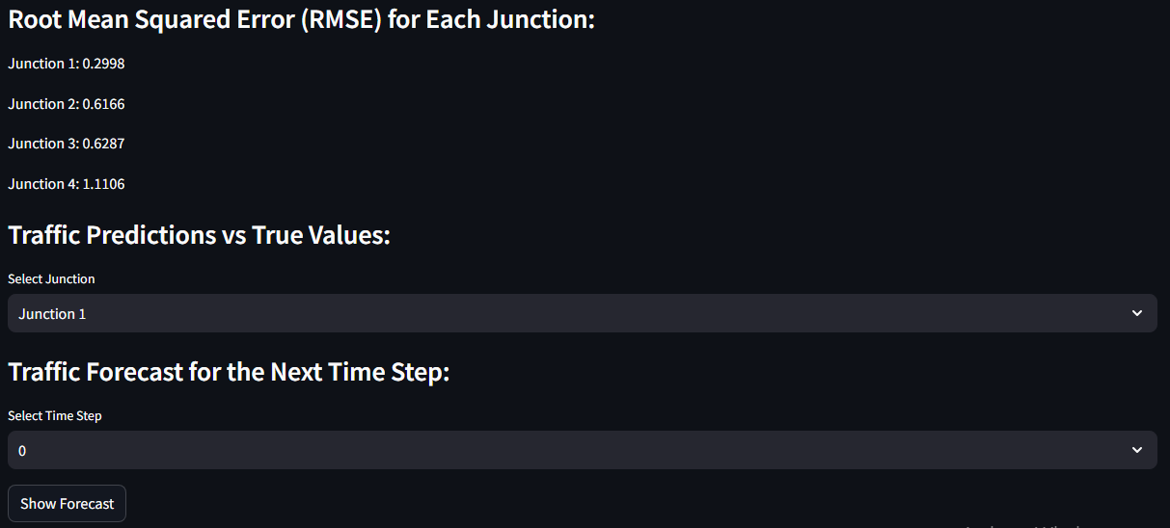
Displays Model Evaluation results
Option to visualize Traffic Predictions Vs. True Values by selecting the dropdown option of each Junctions
Option to visualize Traffic Forecast by selecting the Next Time Step

Slide 31
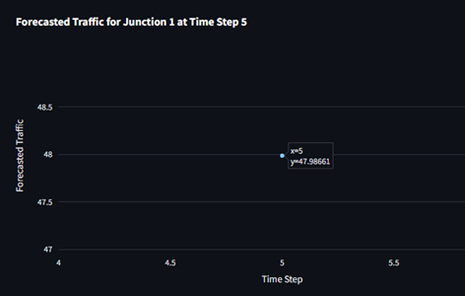

Slide 32
SUMMARY
In this project, I trained a GRU Neural network to predict the traffic on four junctions. I used a Normalization and Differencing transform to achieve a stationary Time Series. As the Junctions vary in Trends and Seasonality, I took different approach for each junction to make it stationary. I applied the Root Mean Squared error as the evaluation metric for the model. In addition to that I plotted the Predictions alongside the original test values
The Number of vehicles in Junction 1 is rising more rapidly compared to Junction 2 and 3. Due to the limitation in data of Junction 4 fails to come up with a conclusion on the same
The Junction 1’s traffic has a stronger weekly seasonality as well as hourly seasonality. Whereas other junctions are significantly linear
Comparing with ARIMA and Prophet model, GRU model gives a better output performance and results.

Slide 33
THANK YOU

